Slide 1

InterviewIQ: AI mock interview using
SpeechRecognition and GPT
Arya Patil 22107047
Nisha Patel 22107037
Prachi Pawar 22107018
Renuka Udugade 22107048
Project Guide
Ms. Poonam Pangarkar
Notes:
1

Slide 2
Outline
Introduction
Literature Survey of the existing systems
Limitations of the existing systems
Problem statement
System Design
Technologies and methodologies
Implementation
Conclusion
References
Notes:
2

Slide 3
Introduction
The modern job market is highly competitive, and interviews are a crucial step in the hiring process.
Traditional interview preparation methods can be time-consuming, expensive, and often lack personalized feedback.
Introducing InterviewIQ , an Al-powered interview simulation platform designed to help candidates ace their interviews.
Leverages cutting-edge Al to provide realistic interview experiences and personalized feedback.
Motivation
To bridge the gap between candidates skills and interview performance.
To reduce interview anxiety and build self-assurance.
Notes:
3

Slide 4
Objectives
To safeguard user data with advanced authentication systems using Clerk Authentication
To generate personalized interview questions to align with job descriptions and skill requirements from AI using Google Gemini.
To provide AI-driven insights on mock interview responses with secure storage and review using Google Gemini, PostgreSQL (Neon), and Drizzle.
To facilitate role-skill mapping through an interactive interface powered by structured skill-role mappings.
Notes:
4

Slide 5
Literature Survey of the existing system
Sr. No | Title | Author | Year | Demerits | Methodology | Outcome
1 | [1] An AI Mock-interview Platform for Interview Performance Analysis | Yi-Chi Chou Chun-Yen Chao Han-Yen Yu | 2022 | This system requires user to type the answers | Speech-to-text | In our system, the user don’t have to type the answers which is time-consuming. In fact, the user will give verbal answers which will be converted into text.
Notes:
5

Slide 6
Literature Survey of the existing system
Sr. No | Title | Author | Year | Demerits | Methodology | Outcome
2 | [2] AI -Based mock interview evaluator | Rubi Mandal Pranav Lohar Dhiraj Patil | 2023 | Doesn’t provide feedback along with answers | Comparing user’s answers with answer stored in database | Our system provides correct answers so that the user gets to know where he/she went wrong.
Notes:
6

Slide 7
Literature Survey of the existing system
Sr. No | Title | Author | Year | Demerits | Methodology | Outcome
3 | [3] AI-Driven Virtual Mock Interview Development | Prabhat Kumar Mishra Arun Kumar Arulappan Thanga Mariappan L | 2024 | This system does not save user’s previous mock interviews | PostgreSQL | Our system saves and retrieve user’s previous mock interviews from PostgreSQL Database.
Sr. No | Title | Author | Year | Outcomes | Methodology | Demerits
1 | [1] An AI Mock-interview Platform for Interview Performance Analysis | Yi-Chi Chou Chun-Yen Chao Han-Yen Yu | 2022 | Further research is needed to understand limitations, such as the accuracy of personality assessments, and the user experience. | The platform uses a video interview format and analyzes various aspects of the candidate's performance. | Further research is needed to understand limitations, such as potential biases in AI analysis, the accuracy of personality assessments, and the user experience.
Notes:
7

Slide 8
Limitations of the existing system
While AI mock interview system offer significant benefits, they also have certain limitations:
Traditional mock interviews, like those with friends or career counselors, Can lack the pressure and realism of a real interview setting.
Scheduling mock interview with professionals or even friends can be time-consuming and inconvenient. This makes consistent practice difficult.
Existing systems may offer a limited range of interview types and questions, not covering the full spectrum of potential interview scenarios.
Notes:
8

Slide 9
Problem statement
Many job seekers struggle to effectively prepare for behavioral interview questions, often giving generic or unstructured responses. This leads to poor interview performance and missed job opportunities.
An AI-powered mock interview platform that provides real-time, personalized feedback, simulates real interview scenarios.
Identifies specific areas for improvement in communication, content, and delivery.
Notes:
9

Slide 10
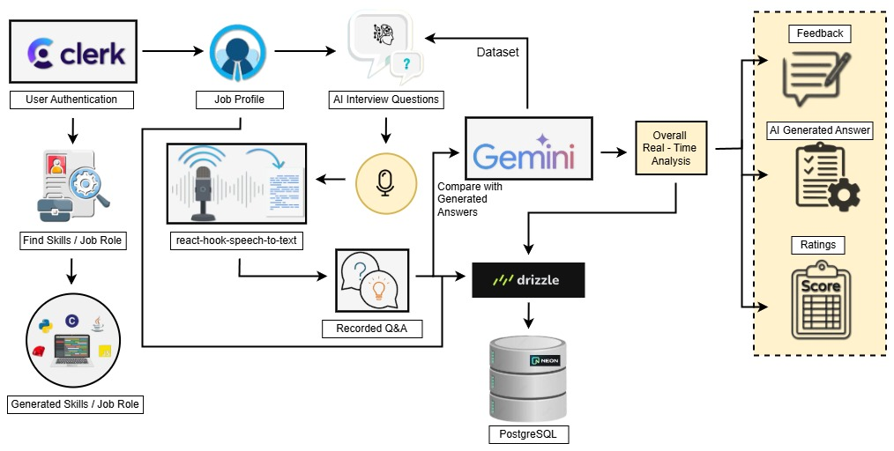
System Design
Notes:
10

Slide 11
Technology and Methodologies
Dataset
Google Gemini
Methodology
Google Gemini 2.0 Flash (Generative Pre-trained Transformer)
SpeechRecognition
Front-end
Next.js (React)
CSS
Back-end
Neondb (Drizzle orm)
Notes:
11

Slide 12
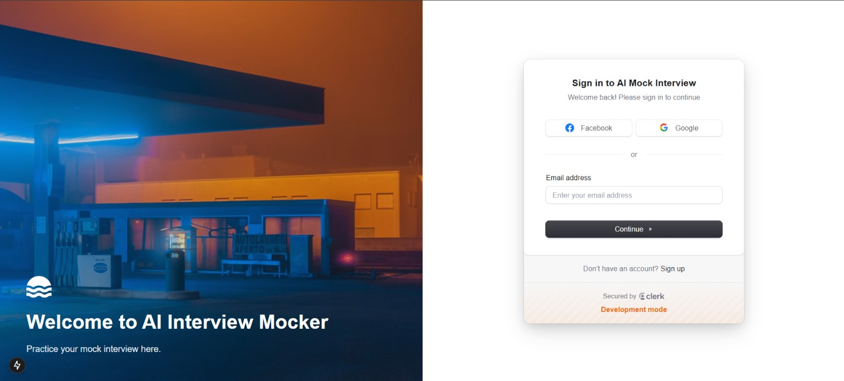
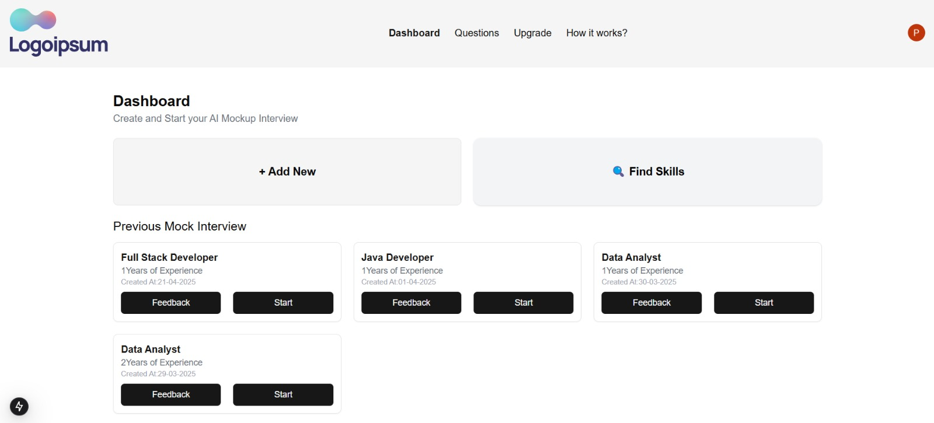
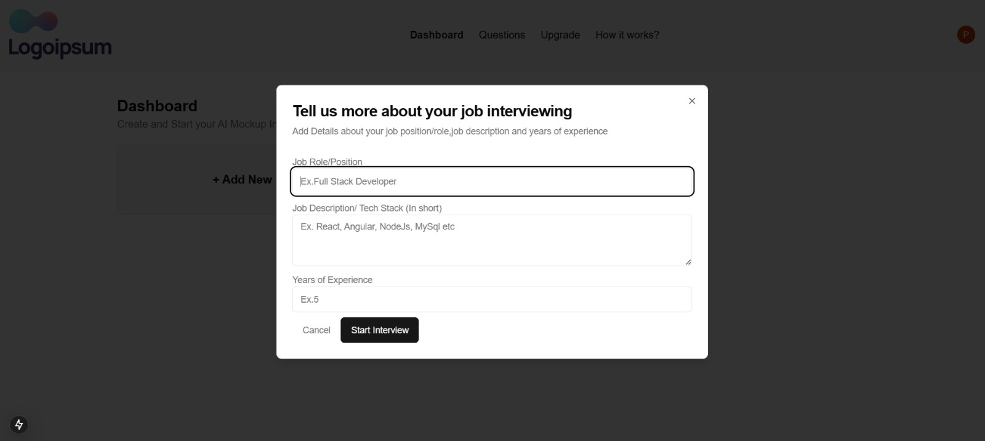
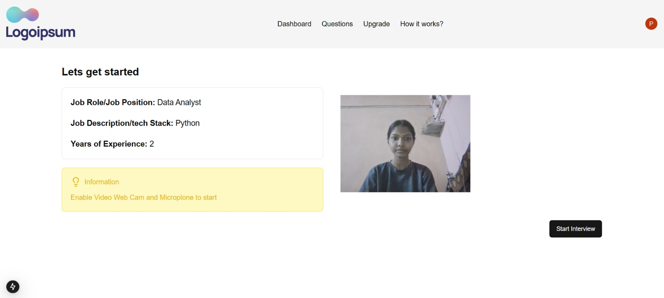
Implementation
Notes:
12

Slide 13
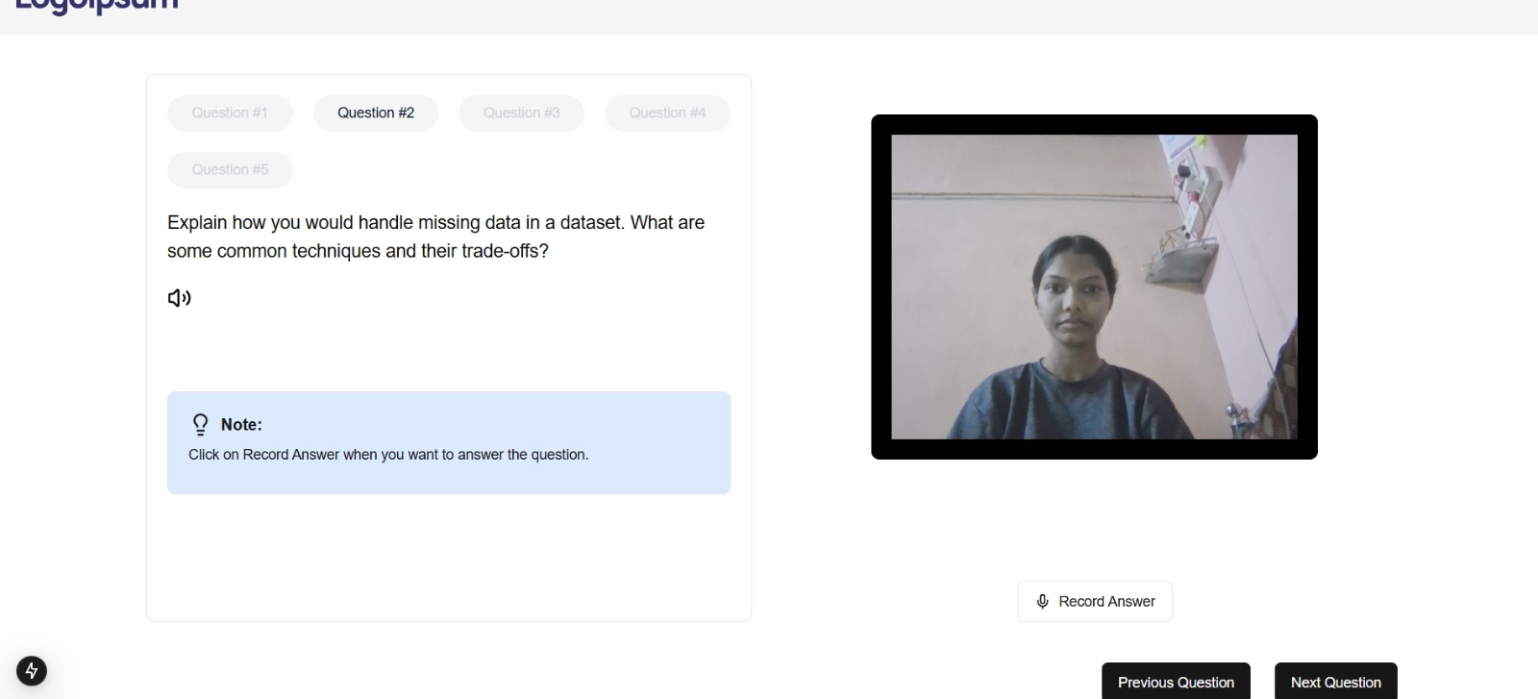
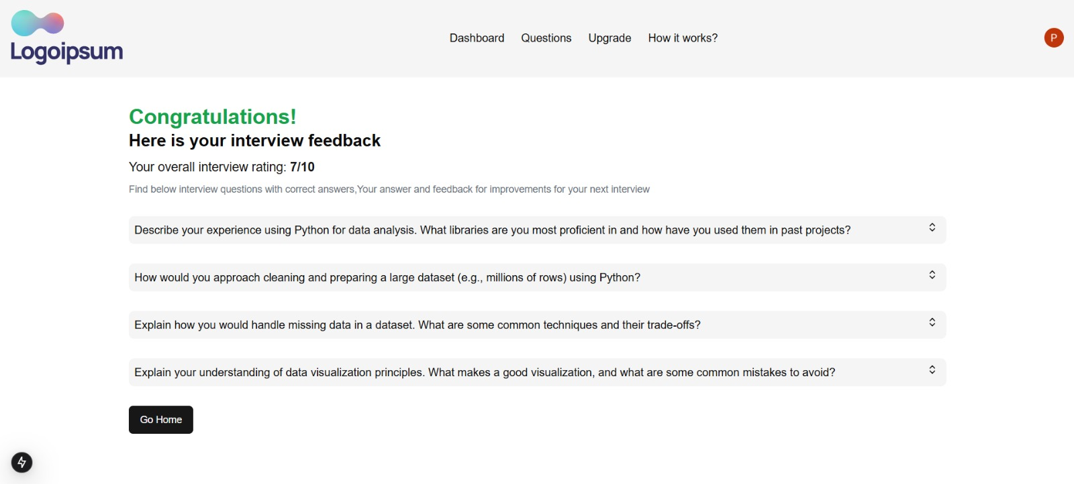
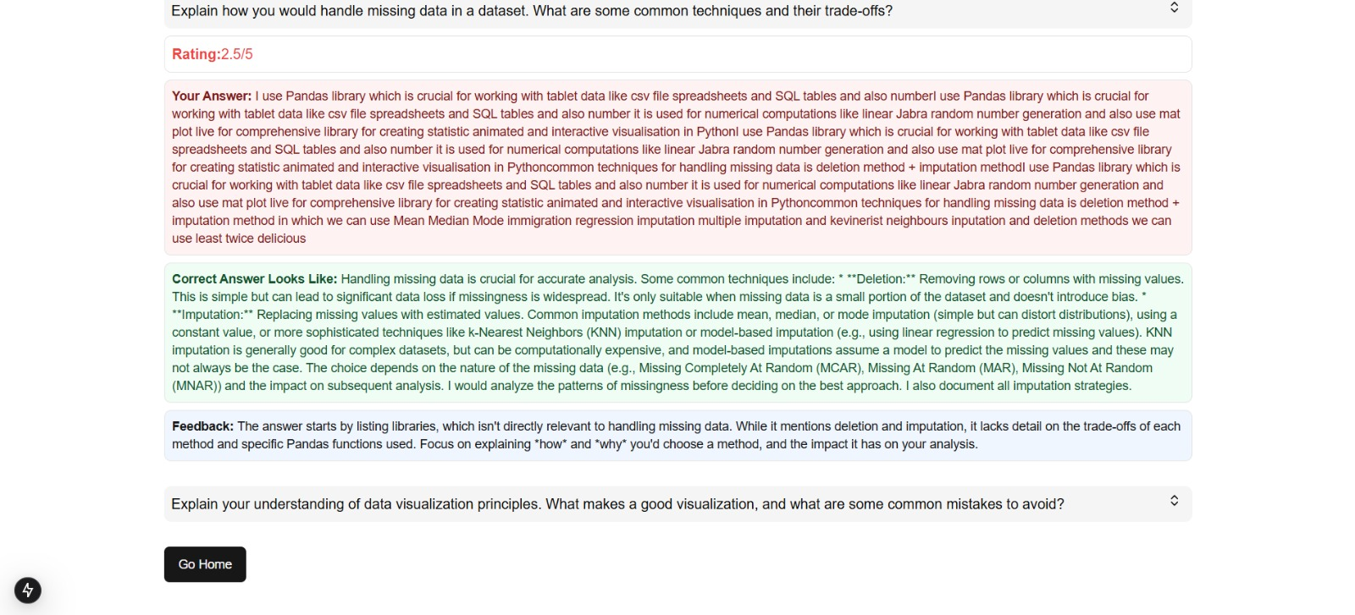
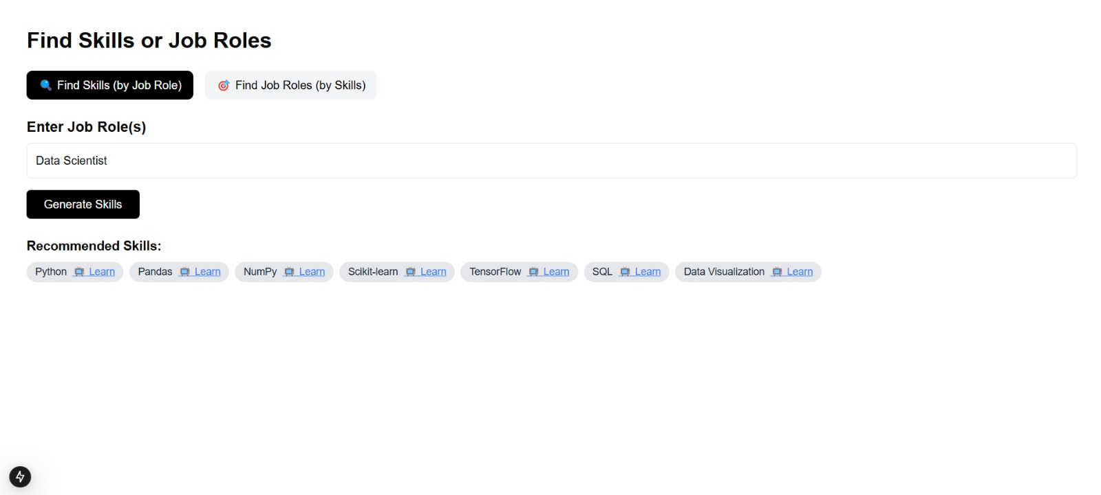
Implementation
Notes:
13

Slide 14
Conclusion
In conclusion, this AI mock interview project has showcased the potential of artificial intelligence to revolutionize the recruitment process.
The insights gained from this project highlight the importance of careful design, ethical considerations, and ongoing refinement to ensure fairness and effectiveness.
Ultimately, the successful implementation of AI in recruitment promises to streamline workflows for recruiters, improve the candidate experience, and ultimately contribute to building stronger and more diverse teams.
Notes:
14

Slide 15
References
[1] Y. -C. Chou, F. R. Wongso, C. -Y. Chao and H. -Y. Yu, "An AI Mock-interview Platform for Interview Performance Analysis," 2022 10th International Conference on Information and Education Technology (ICIET), Matsue, Japan
[2] R. Mandal, P. Lohar, D. Patil, A. Patil and S. Wagh, "AI -Based mock interview evaluator," 2023 International Conference on Intelligent Systems for Communication, IoT and Security (ICISCoIS), Coimbatore, India
[3] P. K. Mishra, A. K. Arulappan, I. -H. Ra, T. M. L, G. R. G and Y. -S. Lee, "AI-Driven Virtual Mock Interview Development," 2024 Joint 13th International Conference on Soft Computing and Intelligent Systems and 25th International Symposium on Advanced Intelligent Systems (SCIS&ISIS), Himeji, Japan.
Notes:
15

Slide 16
Thank You...!!
Notes:
16

